Slide 1
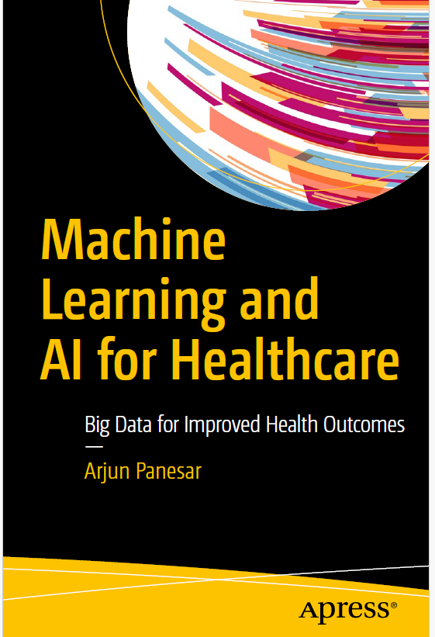
Machine Learning Algorithms
بنام خدا
“Any fool can know. The point is to understand.”
—Albert Einstein
Ali Kabir, MD, MPH, MSc, PhD
Epidemiologist, Internal Medicine Specialist
Associate Professor, Iran University of Medical Science

Slide 2
Not understanding the underlying principles behind an algorithm can lead to a limited understanding of methods or adopting limited interpretations of algorithms.
Understanding the mathematical principles that algorithms are based on is useful to understand best which machine learning techniques are most appropriate.

Slide 3
There is an overwhelming number of machine learning algorithms in the public domain. Many are variations (typically faster or less computationally expensive) on several prominent themes.
Learners are the nucleus of any machine learning algorithm, which attempts to minimize a cost function—also referred to as an error function or loss function—on training and test data.

Slide 4
The most common machine learning tasks are classification, regression, and clustering.
Several algorithms can work for functions of discrete prediction, such as k-nearest neighbors, support vector machines, decision trees, Bayesian networks, and linear discriminant analysis.

Slide 5
Defining Your Machine Learning Project
A computer program is said to learn from experience E with respect to some class of tasks T and performance measure P, if its performance at tasks in T, as measured by P, improves with experience E.
This definition can be used to aid machine learning projects in assisting us to think clearly about what data is collected and utilized (E), what the task at hand is (T), and how we will evaluate the results (P).

Slide 6
Task (T)
The task refers to what we want the machine learning model to do. The function the model learns is the task.
This does not refer to the task of actually learning but rather the task at hand.
For example, a robotic hoover would have the task of hoovering a surface. Often a task is broken down into smaller tasks.

Slide 7
Performance (P)
Performance is a quantitative measure of a machine learning model’s ability.
Performance is measured using a cost function, which typically calculates the accuracy of the model on the task.
The performance can be measured by an error rate, which is the proportion of examples for which the model gives the wrong outputs.
The learning method aims to minimize the error rate, ideally without falling into local minima or maxima.

Slide 8
Experience (E)
Experience refers to the amount of labeled data that is available as well as the amount of supervision required by the machine learning model.

Slide 9
This definition helps understand the data required for collection (E), which develops as the knowledge base; the problem at hand that needs a decision (T); and how to evaluate the output (P).
For example, a prediction algorithm may be assigned task T to predict peak emergency hospital admissions based on experience data E of past hospital admissions and their respective dates and times. The performance measure P could be the accuracy of prediction; and as the model receives more experience data, it would ideally become better in its forecast. It is noteworthy that one criterion does not necessarily determine performance. In addition to accuracy of the prediction, a peak hospital admissions method could provide extra information by predicting peaks that would be the most costly or resource intensive.

Slide 10
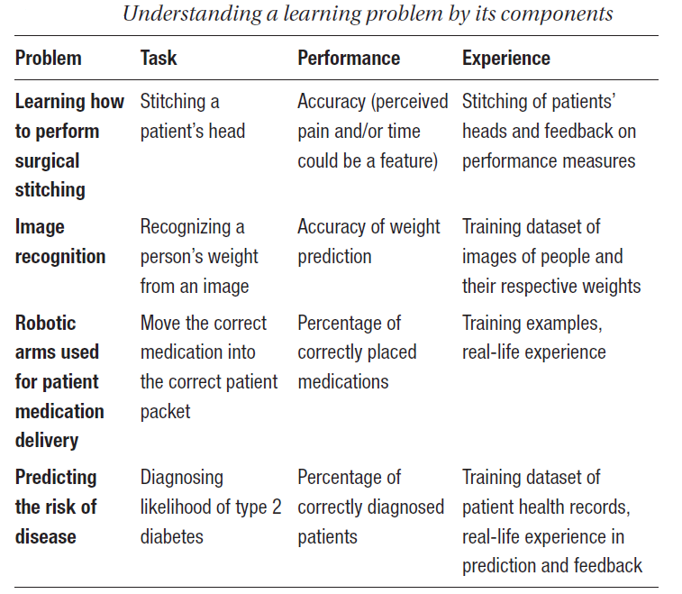

Slide 11
Machine learning is used to answer questions such as “Is it likely I have type 2 diabetes?”; “What object is this in this image?”; “Can I avoid the traffic?”; and “Will this recommendation be right for me?.”
Machine learning is employed favorably in each of these problem domains, yet the complexity of real-world problems means that it is currently infeasible for a specialized algorithm to work faultlessly every time, in every setting, for everyone—whether in healthcare or any other industry.

Slide 12
All models are wrong, but some are useful.
The purpose of machine learning is not to make perfect guesses, as there is no such thing as an ideal model.
Machine learning builds on foundations in statistics to provide useful, accurate predictions that can be generalized to the real world.

Slide 13
When training a machine learning algorithm, the training dataset must be a statistically significant random sample. If this is not the case, there is a risk of discovering patterns that don’t exist, or the noise.
The memorization of training data is known as overfitting. The model remembers the training data, performing well in training but not with previously unknown data.
If the training data is too small, the model can make inaccurate predictions.
The goal of machine learning, whether supervised or unsupervised is generalization—the ability to perform well based on past experiences.

Slide 14
Common Libraries for Machine Learning
Python is increasingly popular within the data science and machine learning industry. All of the libraries are open source on Github, which also provides metrics for popularity and robustness.
Github is a service based on the Git version control system. The Git approach to storing data is stream-like.
Git takes a snapshot of your files and stores references to these snapshots.
Git has three states: committed, modified, and staged—which refers to data storage in your local filesystem, local file changes, and flagged files to be committed, respectively.
The benefits of using metadata are evident when using Github.

Slide 15
Numerical Python, or numpy, is an essential Python extension library. It enables fast, N-dimensional array objects for vector arithmetic, mathematical functions, linear algebra, and random number generation.
Basic array arithmetic performance is noticeably slower without this library.

Slide 16
SciPy is a library for scientific processing that builds on numpy.
It enables linear algebra routines as well as signal and image processing, ordinary differential equation methods, and special functions.

Slide 17
Matplotlib is a Python library of similar data plotting and visualization techniques.
MATLAB is a standard tool used for data processing.
The simplicity and usefulness of Matplotlib helps Python to become a viable alternative to MATLAB.

Slide 18
Pandas is a tool for data aggregation, data manipulation, and data visualization.
Within pandas, one-dimensional arrays are referred to as Series, with multidimensional arrays referred to as DataFrames.

Slide 19
Scikit-learn contains image processing and machine learning techniques.
This library is built on SciPy and enables algorithms for clustering, classification, and regression.
This includes many of the algorithms such as naïve Bayes, decision trees, random forests, k-means, and support vector machines.

Slide 20
NLTK, or Natural Language Toolkit, is a collection of libraries that are used in natural language processing.
The NLTK enables the foundations for expert systems such as tokenization, stemming, tagging, parsing, and classification—which are vital for sentiment analysis and summarization.

Slide 21
Genism is a library for use on unstructured text.

Slide 22
Scrapy is an open source data mining and statistics designed initially for scraping web sites.

Slide 23
TensorFlow is a Google Alphabet-backed open source library of data computations optimized for machine learning.
It enables multilayered neural networks and quick training.
TensorFlow is used in many of Google’s intelligent platforms.

Slide 24
Keras is a library for building neural networks that builds on TensorFlow.

Slide 25
Supervised Learning Algorithms
The goal is to finely tune a predictor function, f(x), or the hypothesis.
The learning comprises of using mathematical algorithms to represent the input data x within a particular domain.
For example, x could take the value of the time of day, and f(x) could be a prediction of waiting time at a particular hospital.

Slide 26
In reality, x typically represents multiple data points. Hence inputs are expressed as a vector. For instance, in the preceding example, f(x) takes in input x as the time of the week. In improving the predictor, we could use not only day (x1), but time (x2) of day, weather (x3), place within the queue (x4), and so on—on the premise the data was available.
Deciding which inputs to use is an integral part of the machine learning design process.

Slide 27
Each record i in the dataset is a vector of features x(i). In the case of supervised learning, there will also be a target label for each instance, y(i). The model is trained with inputs in the form (x(i), y(i)).
The training dataset can be represented as {(x(i), y(i)); i = 1, . . . , N}, where x represents the input and y the output.
The model has the simple form:
f(x) = ax + b, where a and b are constants, and b refers to the noise in the data.

Slide 28
Machine learning aims to find optimal values of a and b such that the predictions f(x) are as accurate as possible.
The method of learning is inductive. The model trawls the training dataset to learn patterns in the data. The model induces a pattern, or hypothesis, from a set of examples.
The output of a machine learning prediction model differs from the actual value of the function due to bias, noise, and variance

Slide 29
Optimization of f(x) takes place through training examples. Each training example {x1 . . . xn} has an input value x_training and a corresponding output, Y.
Each example is processed, and the difference between the known and correct value y (where y ∈ Y) and the predicted value f(h_training) is computed.
After processing a suitable number of samples from the training dataset, the error rate of f(x) is calculated, and values a and b are used as factors to improve the correctness of the prediction.
This also addresses inherent randomness or noise in the data, also referred to as irreducible error.

Slide 30
There are two different main approaches when it comes to feature selection.
First, an independent assessment based on the general characteristics of the data. Methods belonging to this approach are called filter methods, as the feature set is filtered out before model construction.
The second approach is to use a machine learning algorithm to evaluate different subsets of features and finally select the one with the best performance on classification accuracy. The latter algorithm will be used in the end to build a predictive model. Methods in this category are called wrapper methods because the arising algorithm wraps the entire feature selection process.

Slide 31
The law of large numbers theorem applies to machine learning prediction. The theorem describes how the result of a large number of identical experiments will eventually converge, or even out.
This process is iterated until the system converges on the best values for a and b. As such, the machine learns through experience and is ready for deployment. Typically, we are concerned with minimizing the error of a model or making the most accurate predictions possible.

Slide 32
Within supervised machine learning, there are two main approaches: regression-based systems and classification-based systems.

Slide 33
Classification
Classification is the process of determining a category for an item (or items, x) from a set of discrete predefined categories (or labels, y) through approximating a mapping function, f. Classification algorithms use features (or attributes) to determine how to classify an item into at least a binary class, or two or more classes.
Training data is supplied as an input vector. The input vector consists of labels for item features. For instance, an item may read the following:
{“HbA1c, 7.8%”, “Diabetic”} in the form {x_training, output}

Slide 34
It is from the data that classification algorithms learn to classify.
Classification problems require examples to be labeled to determine patterns; hence a model’s classification accuracy is best validated through the correctly classified examples of all predictions made.
Algorithms that perform classification include decision trees, Naïve Bayesian, logistic regression, kNNs (k-nearest neighbors), support vector machine, and so forth.

Slide 35
Common use cases of classification algorithms
Suggesting patient diagnosis based on health profile—that is, does patient have retinopathy?
Recommending the most suitable treatment pathway for a patient
Defining the period in the day in a clinic that there are peak admissions
Determining patient risk of hospital readmission
Classify imagery to identify disease—for example, determining whether a patient is overweight or not from a photograph

Slide 36
Regression
Regression involves predicting an output that is a continuous variable. As a regression-based system predicts a value, performance is measured by assessing the number of prediction errors.
The coefficient of determination, mean absolute error, relative absolute error, and root mean square error are statistical methods used for evaluating regression models.

Slide 37
Regression algorithms include linear regression, regression trees, support vector machines, k nearest neighbor, and perceptrons.
It is often possible to convert a problem between classification and regression. For example, patient HbA1c can also be useful if stored as a continuous value. A continuous value of HbA1c = 6.9% can be classified into a discrete category, diabetic, on rules defined on HbA1c as Diabetic (Set 1): HbA1c ≥ 6.5%, Non-diabetic (Set 2): HbA1c < 6.5%.

Slide 38
Time series refers to input data that is supplied in the order of time.
The sequential ordering of the data adds a dimension of information. Time series regression problems are commonplace.

Slide 39
Common use cases of regression algorithms
Estimating patient HbA1c from previous blood glucose readings (time series forecasting)
Predicting the days before hospital readmission (which may be received as a time-series regression problem)
Approximating patient mortality risk based on clinical data
Forecasting the risk of developing health complications
Forecasting when the office printer will be queued with requests from other employees

Slide 40
Decision trees
Decision trees are flowcharts that represent the decision-making process as rules for performing categorization.
Decision trees start from a root and contain internal nodes that represent features and branches that represent outcomes. As such, decision trees are a representation of a classification problem.
Decision trees can be exploited to make them easier to understand. Each decision tree is a disjunction of implications (i.e., if–then statements), and the implications are Horn clauses that are useful for logic programming. A Horn clause is a disjunction of literals.

Slide 41
On the basis that there are no errors in the data in the form of inconsistencies, we can always construct a decision tree for training datasets with 100% accuracy. However, this may not roll out in the real world and may indicate overfitting.

Slide 42
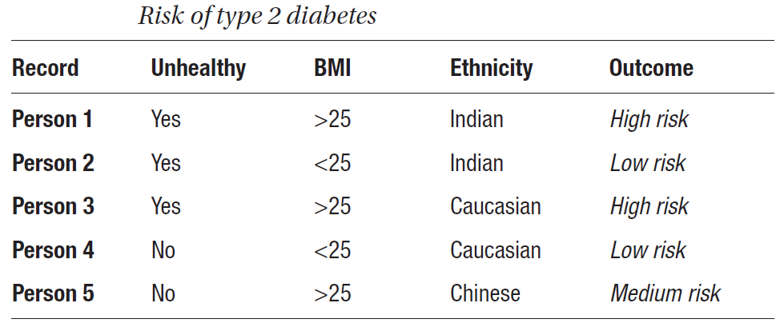

Slide 43
Classifying an example involves subjecting the data to an organized sequence of tests to determine the label. Trees are built and tested from top to bottom as so:
1. Start at the root of the model
2. Wait until all examples are in the same class
3. Test features to determine best split based on a cost function
4. Follow the branch value to the outcome
5. Repeat number 2
6. Leaf node output

Slide 44
The central question in decision tree learning is which nodes should be placed in which positions, including the root node and decision nodes.
There are three main decision tree algorithms. The difference in each algorithm is the measure or cost function for which nodes, or features, are selected. The root is the top node. The tree is split into branches; evaluated through a cost function; and a branch that doesn’t split is a terminal node, decision, or leaf.

Slide 45
Decision trees are useful in the way that acquired knowledge can be expressed in an easy to read and understandable format.
It mimics human decision-making whereby priority—determined by feature importance, relationships, and decisions—is clear.
They are simple in the way that outcomes can be expressed as a set of rules.

Slide 46
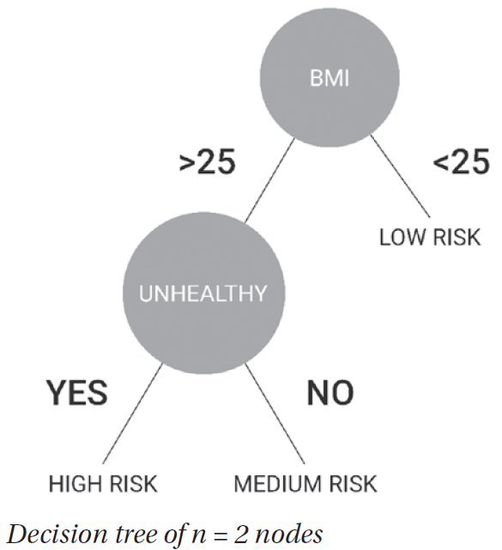

Slide 47
Decision trees provide benefits in how they can represent big datasets and prioritize the most discriminatory features.
If a decision tree depth is not set, it will eventually learn the data presented and overfit.
It is recommended to set a small depth for decision tree modeling.
Alternatively, the decision tree can be pruned, typically starting from the least important feature, or the incorporation of dimensionality reduction techniques.

Slide 48
Overfitting is a common machine learning obstacle, and not limited to decision trees. All algorithms are at risk of overfitting, and a variety of techniques exist to overcome this problem. Random forest or jungle decision trees can be extremely useful in this.
Pruning reduces the size of a decision tree by removing features that provide the least information. As a result, the final classification rules are less complicated and improve predictive accuracy.

Slide 49
The accuracy of a model is calculated as the percentage of examples in the test dataset that is classified correctly.
True Positive / TP: Where the actual class is yes, and the value of the predicted class is also yes
False Positive / FP: Actual class is no, and predicted class is yes
True Negative / TN: The value of the actual class is no, and the value of the predicted class is no
False Negative / FN: When the actual class value is yes, but predicted class is no
Accuracy: (correctly predicted observation)/(total observation) = (TP + TN)/(TP + TN + FP + FN)
Precision: (correctly predicted Positive)/(total predicted Positive) = TP/TP + FP
Recall: (correctly predicted Positive)/(total correct Positive observation) = TP/TP + FN

Slide 50
Classification is a common method used in machine learning; and ID3 (Iterative Dichotomizer 3), C4.5 (Classification 4.5), and CART (Classification And Regression Trees) are common decision tree methods where the resulting tree can be used to classify future samples.

Slide 51
Iterative Dichotomizer 3 (ID3)
Python: scikit-learn; Method: decision-tree-id3
Ross Quinlan has contributed significantly to the area of decision tree learning, developing both ID3 and C4.5.
The ID3 algorithm uses the cost function of information gain, based on work from “the father of information theory” Claude Shannon. Information gain is calculated through a measure known as entropy.

Slide 52
Entropy determines how impure, or disordered, a data set is.

Slide 53
ID3 selects the node with the highest information gain to produce subsets of data that are then applied the ID3 algorithm on recursively.
The information gain of an attribute can be understood as the expected loss in entropy as the result of learning the value of attribute A.
The algorithm terminates once it exhausts the attributes or the decision tree classifies the examples completely. ID3 is a classification algorithm that is unable to cater for missing values.

Slide 54
For example, if the following row were to be received, the model would categorize the outcomes as high risk. There is a chance that ethnicity is a determining factor in the outcome. However, there is not enough data for the model to learn the potential outcome.

Slide 55
C4.5
Python: scikit-learn; Method: C45algorithm
C4.5 is an enhancement built on ID3 that takes number and size of branches into account when choosing an attribute.
C4.5 can handle continuous and discrete labels and uses gain ratio as its splitting criteria.
It improves on the execution time and accuracy as the size of the dataset increases.
C4.5 introduces pruning—a bottom-up technique also known as subtree raising—and subtree replacement to ensure the model doesn’t overfit the data.

Slide 56
CART
Python: scikit-learn; Method: cart
CART, or Classification And Regression Trees, use Gini index as the cost function. Represented as a binary tree, as with C4.5, CART can be used for regression and classifications problems.
While entropy is used for exploratory analysis, Gini is to minimize misclassification.

Slide 57
Ensembles
An ensemble is a form of machine learning algorithm.
Ensemble methods use a collection of machine learning models or learners.
As a result, a group of weak learning models is combined to create a more accurate learner.

Slide 58
Bagging
Bagging is an ensemble technique that involves creating multiple independent models with datasets using the bootstrap sampling technique.
The technique aids in reducing error by reducing variance.
In general, bagging improves predictions as anomalous behaviors are averaged out. In comparison, a collection of iterative predictive models is known as boosting.

Slide 59
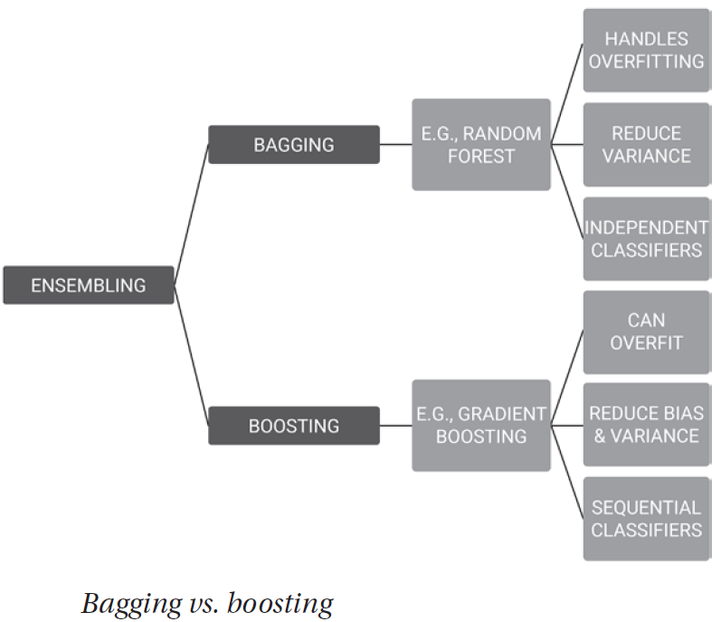

Slide 60
In bagging, n′ < n samples are taken from dataset D with replacement.
A random selection of features for constructing the best split is chosen each time.
An average, majority vote, or statistical method, is used to determine the average prediction from a model.
Random forest decision trees extend the concept of bagging, as they use a random subset of features too, resulting in less correlation among predictions from learners.

Slide 61
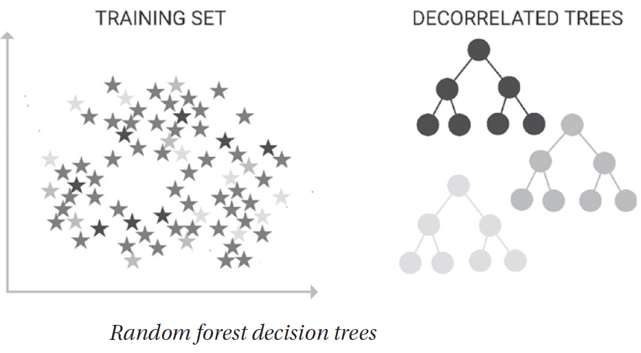

Slide 62
Random Forest Decision Trees
Python: scikit-learn; Method: RandomForestClassifier
Random forests are created through training multiple decision trees at the same time and refer to a collection of decision tree learners (hence the “forest”).
The purpose of random forests is to prevent overfitting. The more decision trees in the random forest, the more accurate results are.
Each random forest takes a sample of the dataset and a random subset of features for decision.
Random forest decision trees can be used for classification and regression problems. With regression problems, an average of the outcomes is taken; whereas with classification problems, it is the majority category.

Slide 63
A random forest decision tree is an ensemble of different models.
This is an ensemble method due to the procedure reducing variance in the algorithm through combining predictions from multiple models.
The random forest model seems to work particularly well when data is limited to classification or decision problems by bootstrapping existing data.
A benefit of random forest classifiers is that it can also handle missing values.

Slide 64
Boosting
Boosting is an ensemble method that produces a collection of predictive models iteratively. The concept involves each new model learning from the errors of previous models.
Boosted methods are typically implemented when there is a plethora of data for prediction.
Through iteratively creating new models to compensate for error, the process “boosts” or converts weak learners into strong learners—reducing their bias and variance.
Each iteration of the technique learns relationships in the data and is then subsequently analyzed for errors, with incorrect classifications given a weighting. The aim is to minimize the error from the previous model.
The underlying machine learning method used for boosting algorithms can be anything.

Slide 65
Boosting works through the following process:
1. Data is represented
2. Decision stump is made on the most significant cut of features
3. Weightings are given to misclassified observations
4. The process is repeated and all stumps combined to achieve final classifier

Slide 66
Gradient Boosting
Python: scikit-learn; Method: GradientBoostingClassifier, GradientBoostingRegressor
Gradient boosting is known by many names including multiple additive regression trees, stochastic gradient boosting, and gradient boosting machines.
Gradient boosting is a technique derived from decision trees when Jerome Friedman applied the gradient boosting concept to decision trees in 2001.
AdaBoost (Freund and Shapire, 2001) is a gradient boosting variant. In gradient boosting, the model is trained sequentially. Each iterative model seeks to minimize the loss function.

Slide 67
Similar to random forest decision trees, gradient boosting is made from weak predictors. Each new tree is subsequently trained with the data previously incorrectly classified by the previous tree.
This iterative procedure expedites the model by focusing on more challenging data as easier predictions are made early on in learning.
XGBoost, or extreme gradient boosting, are variations of gradient boosting. XGBoost adds regularization and takes advantage of computing power with distributed, multithreaded processing for greater speed and efficiency.

Slide 68
Adaptive Boosting
Python: scikit-learn, numpy; Method: AdaBoostClassifier, AdaBoostRegressor
Adaptive boost is a popular method that iteratively learns from mistakes.
Decision tree stumps are weak learners, splitting data by one rule only. The decision tree stump is improved by focusing on samples that were incorrectly classified.
These are identified through weightings that are associated with the data. The model can learn from its mistakes and provides a final solution with lower bias than a single decision tree.

Slide 69
Linear Regression
Python: scikit-learn; Method: linear_model.LinearRegression
Linear regression is a continuous statistical technique to understand the relationship between input (x: predictors, explanatory or independent variables) and output (y: response or dependent variable).
Linear regression requires that y be calculated from a linear combination of input variables.
The aim is to place a line of best fit through all of the data points, which enables easy understanding of predictions by minimizing margin or residual variation.

Slide 70
where yi is the actual observed response value; ˆyi is the predicted value of response variable; and their subtraction is the residual variation or difference between observed and predicted values of y.
Criterion variable: outcome variable we are predicting
Predictor: what variable predictions are based on
Intercept: where the line of best fit intercepts the y-axis
When there is one input variable x, this technique is known as simple linear regression. Multiple linear regression evaluates two or more predictor variables.

Slide 71
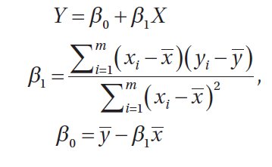
where y is the output variable, x is the predictor, B0 and B1 are coefficients that are estimated to move the line of best fit, x̄ refers to the mean of x, B0 is the bias or intercept (where it intercepts the y-axis), and B1 is the slope or rate at which y increases/decreases per unit of x.

Slide 72
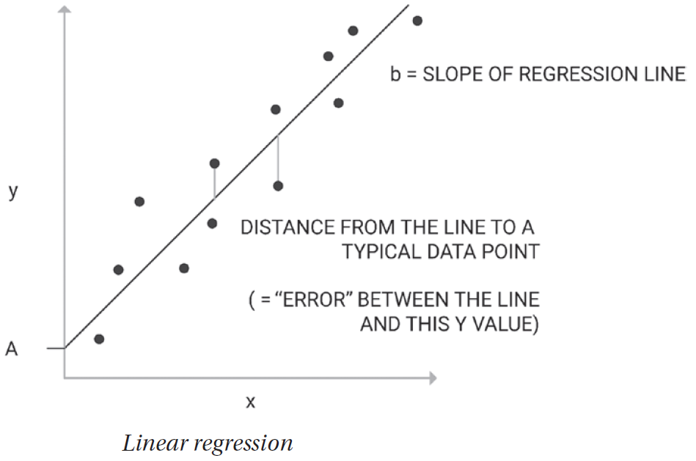

Slide 73
Once the model has learned the parameters, they are used to predict values of y given new, unseen input X.
Popular techniques used to estimate the coefficients are ordinary least squares and gradient descent. Given a line of best fit placed through a sample dataset with a linear relationship, ordinary least squares attempts to minimize the sum of the squared distances from each data point to the regression line. The intention is to minimize the sum of squared residuals.
Coefficient values are iteratively optimized to reduce the error of the model.

Slide 74
Ordinary least squares start with random values for B0 and B1.
The sum of squared errors is calculated for each (input, output) pair.
A learning rate is chosen, which acts as a scale factor; and the coefficients are optimized toward minimizing the error until no further gains can be made.
A learning rate is a hyperparameter that has its value determined by experimentation. Different values are tried, and the value that gives the best results is used.

Slide 75
Criticisms of linear regression focus on its simplicity, resulting in it being unable to capture complex relationships within the data. Noise in the data can also be learned by the model, resulting in overfitting.
Relationships between variables are not always linear, and therefore a linear regression model can perform poorly on data with nonlinear relationships.
However, variables can sometimes be transformed to fit a linear regression model. Linear regression also assumes variables are homoscedastic, which means all variables in the vector have the same variance.

Slide 76
The aforementioned is a perfect demonstration as to why when training a model, one should use a variety of machine learning algorithms.

Slide 77
Logistic Regression
Python: scikit-learn; Method: linear_model.LogisiticRegression
Linear regression applies to continuous variables, whereas logistic regression predictions apply to discrete values or classification problems after the application of a transformation function.

Slide 78
Developed by statistician David Cox in 1958, logistic regression (or logit regression) is often used for binary classification problems. For example, logistic regression can be used to predict whether a patient will experience an adverse event given a particular medication; whether a patient is likely to be readmitted to a hospital or not; or whether a patient has a particular disease diagnosis.

Slide 79
Unlike linear regression, the output of the model comes in the form of a probability between 0 and 1. The predicted output is generated by log-transforming the x input and using the logistic function h(x) = 1/(1 + e^ –x). A specified threshold is used to transform this probability into a binary classification.
Logistic regression uses the sigmoid function, an S-shaped curve that can take any continuous value and map it into a probability value between 0 and 1 for a default class.

Slide 80
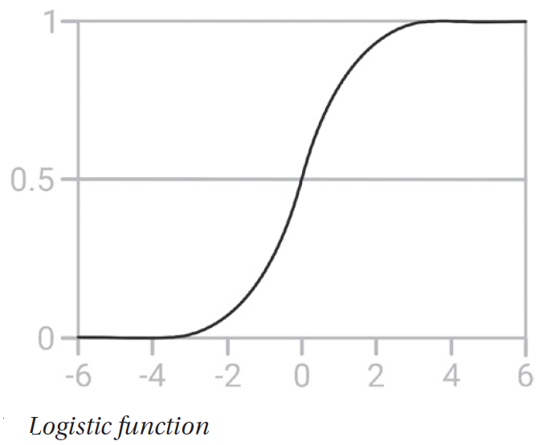

Slide 81
Sigmoid function: 1/(1 + e^–value), where e Euler’s number and value is the value requiring transformation.
Logistic regression uses an equation P(x) = e ^ (b0 + b1*x)/(1 + e^(b0+b1*x)), which can be transformed into ln(p(x)/1–p(x)) = b0 +b1*x).
As with linear regression, b0 and b1 are values learned from the training data.

Slide 82
As an example, take a model that determines whether a growth on the skin surface is benign or not. The input variable, x, could be the size, depth, or texture of the growth; and the default variable y = 1 indicates a benign growth.
As depicted, the logistic function transforms the x-value of the various instances into a probability value between 0 and 1. If the probability crosses the threshold of 0.5, the tumor is classified as benign.

Slide 83
Logistic regression seeks to learn values of b0 and b1 through training that minimize the error between predicted and actual outcomes.
Maximum likelihood estimation is an iterative procedure used for this purpose. Maximum likelihood estimation starts with a random value as the best weight for each predictor variable and then adjusts these coefficients iteratively until there is no improvement in the ability to predict the outcome value.
The final coefficients have a value that minimizes the error in the probabilities predicted.

Slide 84
As with linear regression, logistic regression assumes a linear relationship between input variables and output. Feature reduction may be required to transform data into linear models.
Logistic regression models are also prone to overfitting, which may be overcome through the removal of highly correlated inputs. Finally, it is possible that coefficients fail to converge, which can happen if data is sparse or highly correlated.

Slide 85
SVM
Python: scikit-learn Method: svm.SVC, svm.LinearSVC
Support vector machine (SVM) is a nonprobabilistic binary linear classifier used with both classification and regression problems.
SVM is often used along with Natural language processing (NLP) methods to analyze text for topic modeling and sentiment analysis. It is also used in image recognition problems and handwriting digit recognition.

Slide 86
The algorithm finds a hyperplane, or line of best fit, between two classes determined by the support vectors.
Support vectors are the data points nearest the hyperplane that would alter the position of the hyperplane if removed. The greater the margin value, or distance from the data points to the hyperplane, the more confidence there is that the data is appropriately classified.
The line of best fit is learned from an optimization procedure that seeks to maximize the margin.

Slide 87
SVM uses something known as kernelling to map data to higher dimensional feature spaces. Data is mapped using the kernel trick in iteratively more dimensions until a hyperplane can be formed to classify it.

Slide 88
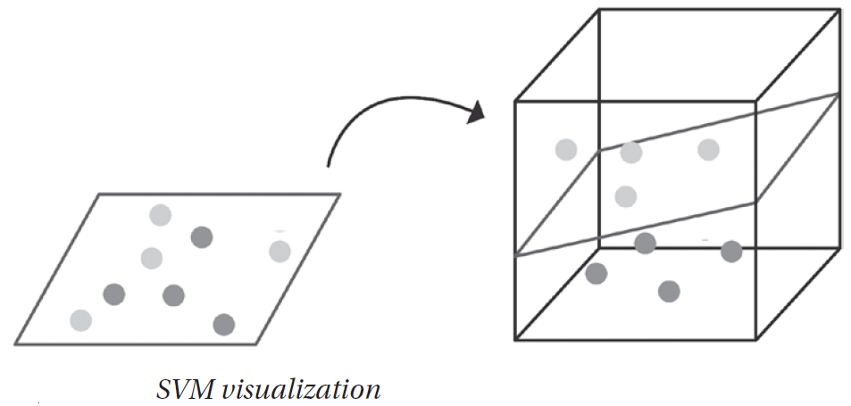
Take the problem in above Figure. On the left, we see that it would be impossible to find a line of best fit in two dimensions.
SVM uses the kernel trick to map data into three dimensions and can define a hyperplane to classify the data.

Slide 89
SVMs take numerical inputs and work well on small datasets.
However, as dimensionality increases, the ability to understand and explain the model reduces.
As dataset size increases, so too can training time. SVMs are also less capable on noisy data.
The SVM can be expressed as a sum over the support vectors:

Slide 90
Naive Bayes
Python: scikit-learn; Method: GaussianNB, MultinomialNB, BernoulliNB
Naïve Bayes uses Bayes’ theorem to calculate the probability an event will occur given another event has already occurred.
The algorithm is acknowledged as naïve because it assumes all variables are independent of each other, which is atypical of real-world examples.
The Bayesian classifier is often used when input dimensionality is high.

Slide 91
For example, given a specified threshold, this method can be used to probabilistically classify whether a vector is in one class or another:
P(B|A) = (P(A|B) * P(B))/P(A)
P(B|A) = Posterior probability. Probability of hypothesis B being true, given the data A, where P(B|A)= P(a1|b) * P(a2|b) * . . . * P(an|b) * P(A)
P(A|B) = Likelihood: the probability of data A given that the hypothesis B was true
P(A) = Class prior probability
P(B) = Predictor prior probability

Slide 92
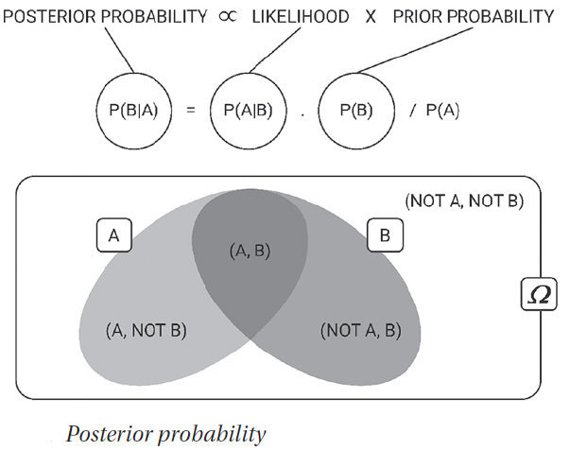
The prior distribution P(B) and likelihood probability P(B|A) can be estimated from the training data. To calculate which class an example belongs to, the probability of being in each class is calculated. The class assigned to an example is the class that produces the highest probability for the example.

Slide 93
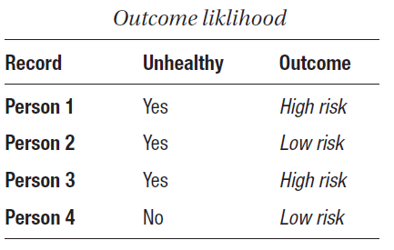
Using this Table as a simple example, we can learn the probability of a patient’s disease risk from whether they are unhealthy or not.
To determine the outcome for unhealthy = yes, we calculate P(high risk|unhealthy) and P(low risk|unhealthy) and choose the outcome with the highest probability.

Slide 94
Naïve Bayesian models are easy to build and particularly useful for extensive data sets. Along with its simplicity (and hence its naïvety), Naïve Bayes is known to outperform even highly sophisticated classification methods.

Slide 95
kNN: k-nearest neighbor
Python: scikit-learn; Method: neighbors.KNeighborsClassifier
Not to be confused with k-means clustering, the kNN method classifies an unknown object O with the label of the majority of the k-nearest neighbors.
Used in classification and regression problems, kNNs are a nonparametric technique; they do not learn a model. Instead, kNNs store the training dataset as its representation and perform classification of a new sample based on learning by analogy.
As there is no learning of the model, kNNs are considered lazy learners.

Slide 96
Each object represents a point in N-dimensional space. A neighbor is defined nearest if it has the smallest distance in feature space. The distance between an unseen object and its neighbor is calculated using the Euclidian distance between A = (a1 . . . an) and B = (b1 . . . bn) as follows:

Slide 97
The algorithm works as such:
1. Calculate the distance between any two points
2. Find the nearest neighbors based on these pairwise distances
3. Majority vote on a class label based on the nearest neighbors list

Slide 98
The prediction is made at the time of the request.
In regression problems, the mean or median of the k-most similar instances is used.
In classification problems, the class with the highest frequency from the k-most similar instances is selected.
As with most algorithms, the determinant method can vary. The distance between binary vectors (Hamming distance) and the sum of absolute difference between real vectors (Manhattan distance) are also used.

Slide 99
A disadvantage of kNNs is the large computing requirement for classifying an object, as the distance for all neighbors in the training dataset must be calculated.
It is not particularly well suited to high- dimensional data. Each predictor variable can be considered a dimension of n-dimension input space.
For instance, x1 would be one-dimensional and x1, x2 two-dimensional, and so on. The increase in dimensionality exponentially increases the volume of the input space.

Slide 100
kNNs are not well suited to data with missing values, as distances between vectors cannot be calculated on missing data.

